Slide 1
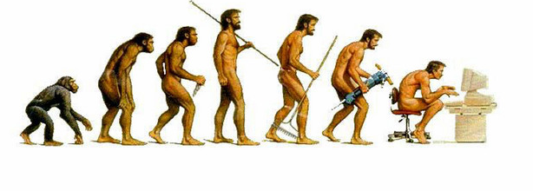
Software Evolution

Slide 2
Software change
Software change is inevitable
A key problem is implementing and managing change to existing software systems.

Slide 3

Importance of evolution
Organizations have huge investments in their software systems
Must be changed and updated to maintain value.
The majority of the software budgets are devoted to changing and evolving existing software.

Slide 4
Evolution and servicing
Evolution: System is in use and is evolving as new requirements are proposed and implemented.
Servicing: Software remains useful but the only changes made are those required to keep it operational. No new functionality is added.
Phase-out: Software may still be used but no further changes are made to it.

Slide 5
Evolution processes
Software evolution processes varies
Proposals for change are the driver for system evolution.
Change identification and evolution continues throughout the system lifetime.

Slide 6
Change implementation
Revisions to the system are designed, implemented and tested.
May involve a program understanding phase

Slide 7
Urgent change requests
Urgent changes may have to be implemented without going through all stages of the software engineering process.

Slide 8
Quiz Questions
1-3

Slide 9
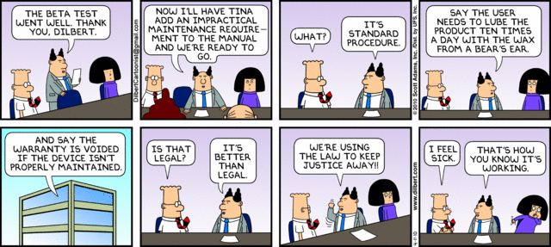
Software Maintenance

Slide 10
Software maintenance
Modifying a program after it has been put into use.
Maintenance does not normally involve major changes to the system’s architecture.
Changes are implemented by modifying existing components and adding new components to the system.

Slide 11
Types of maintenance
Maintenance to repair software faults
Maintenance to adapt software to a different operating environment
Maintenance to add to or modify the system’s functionality

Slide 12
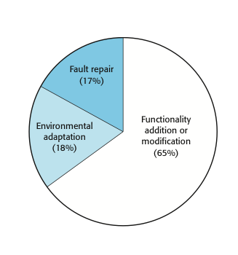
Maintenance effort distribution

Slide 13
Maintenance costs
Usually greater than development costs
Affected by both technical and non-technical factors.
Increases as software is maintained.

Slide 14
Maintenance cost factors
Team stability
Contractual responsibility
Staff skills
Program age and structure

Slide 15
Quiz Questions
4-6

Slide 16
System Re-Engineering

Slide 17
System re-engineering
Re-structuring or re-writing part or all of a system without changing its functionality.
Involves adding effort to make a system easier to maintain.

Slide 18
Advantages of reengineering
Reduced risk
Reduced cost

Slide 19
Re-engineering process activities
Source code translation
Reverse engineering
Program structure improvement
Program modularization
Data re-engineering

Slide 20
Reengineering cost factors
The quality of the software to be reengineered.
The tool support available for reengineering.
The extent of the data conversion which is required.
The availability of expert staff for reengineering.

Slide 21
Refactoring

Slide 22
Preventative maintenance by refactoring
The process of making improvements to a program to slow down degradation through change.
Modifying a program to improve its structure, reduce its complexity or make it easier to understand.

Slide 23
Refactoring VS. Re-engineering
Re-engineering takes place after a system has been maintained for some time and maintenance costs are increasing
Refactoring is a continuous process of improvement throughout the development and evolution process.

Slide 24
Potential problems in program code
Duplicate code
Long methods
Switch (case) statements
Data clumping
Speculative generality

Slide 25
Quiz Questions
7-9

Slide 26
Legacy Systems

Slide 27
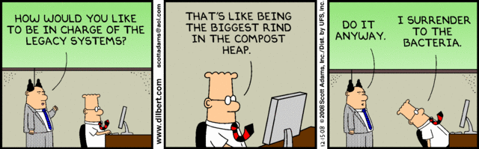
Legacy Systems
Legacy systems are systems that are still useful and are sometimes critical to business operations
It may not be cost effective to replace these systems

Slide 28
Legacy system management
Strategies
Scrap the system
Continue maintaining
Re-engineer
Replace
The strategy chosen should depend on the system quality and its business value.

Slide 29
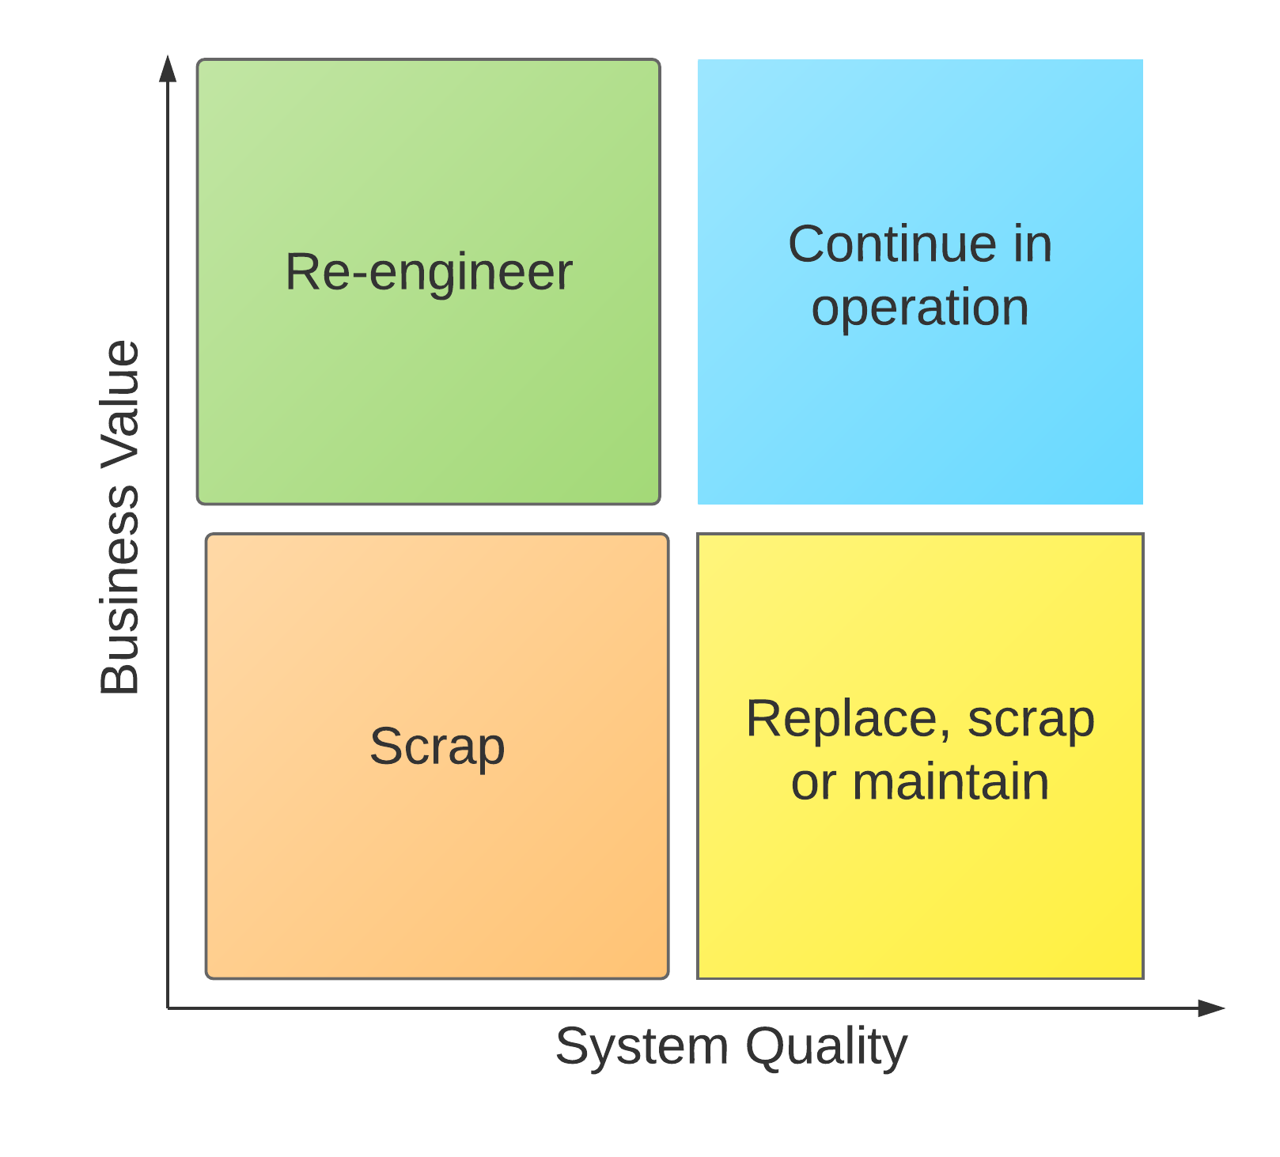
Legacy System Categories

Slide 30
Business value assessment
Assessment should take different viewpoints into account
Interview different stakeholders and collate results.

Slide 31
Issues in business value assessment
The use of the system
The business processes that are supported
System dependability
The system outputs

Slide 32
System quality assessment
Business process assessment
Environment assessment
Application assessment

Slide 33
Quality measurement
Can collect quantitative data to make an assessment of the quality of the application system.

Slide 34
Quiz Questions
10-12

